Slide 1
12/01/2024
Download Visual Studio Code
Get started on ‘Proper’ Python Programming
(if there is enough time)

Slide 2

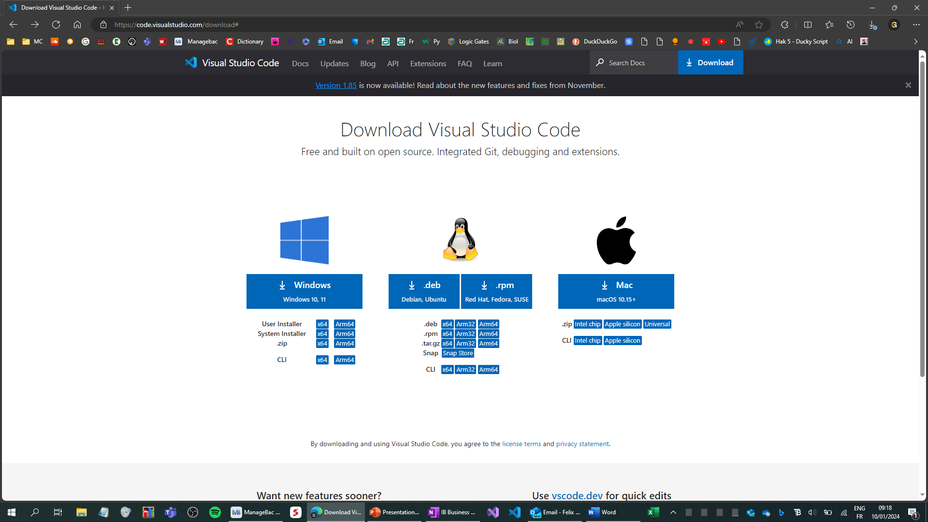
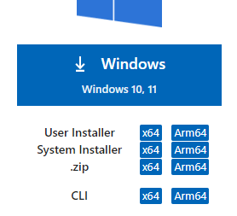
Download Visual Studio Code
Go to this website: https://code.visualstudio.com/download#

Slide 3
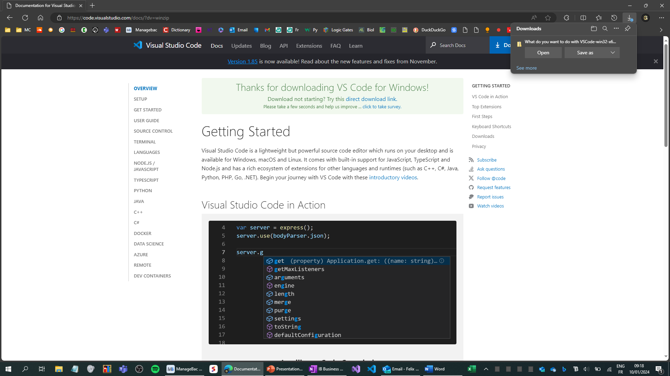
Download Visual Studio Code
It should go to this webpage:

Slide 4
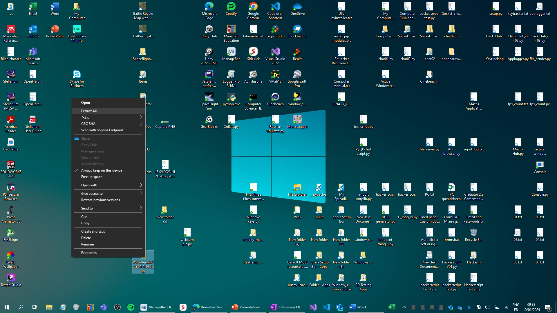
Download Visual Studio Code
Extract the file:

Slide 5
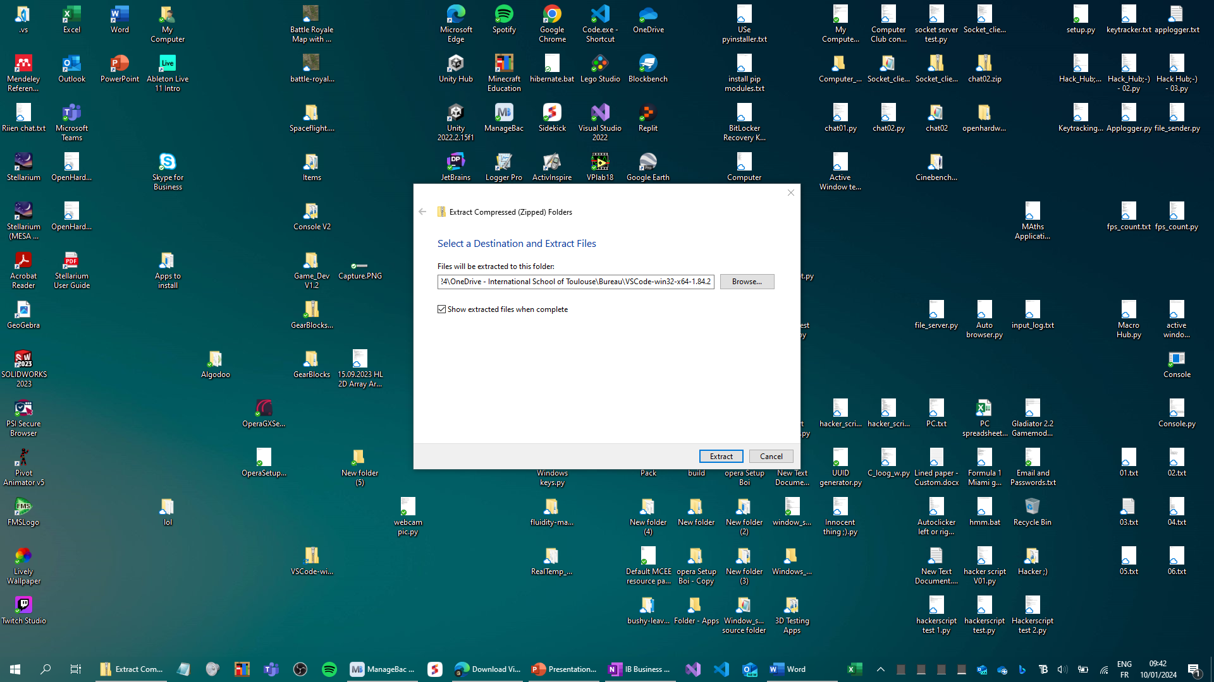
Download Visual Studio Code
Select the location of the extracted VSC folder:

Slide 6
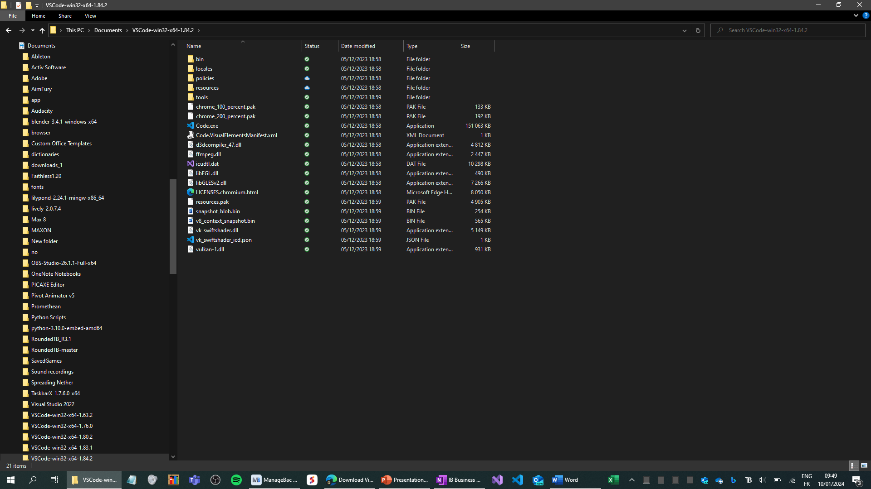
Download Visual Studio Code
Open the Code.exe file:

Slide 7
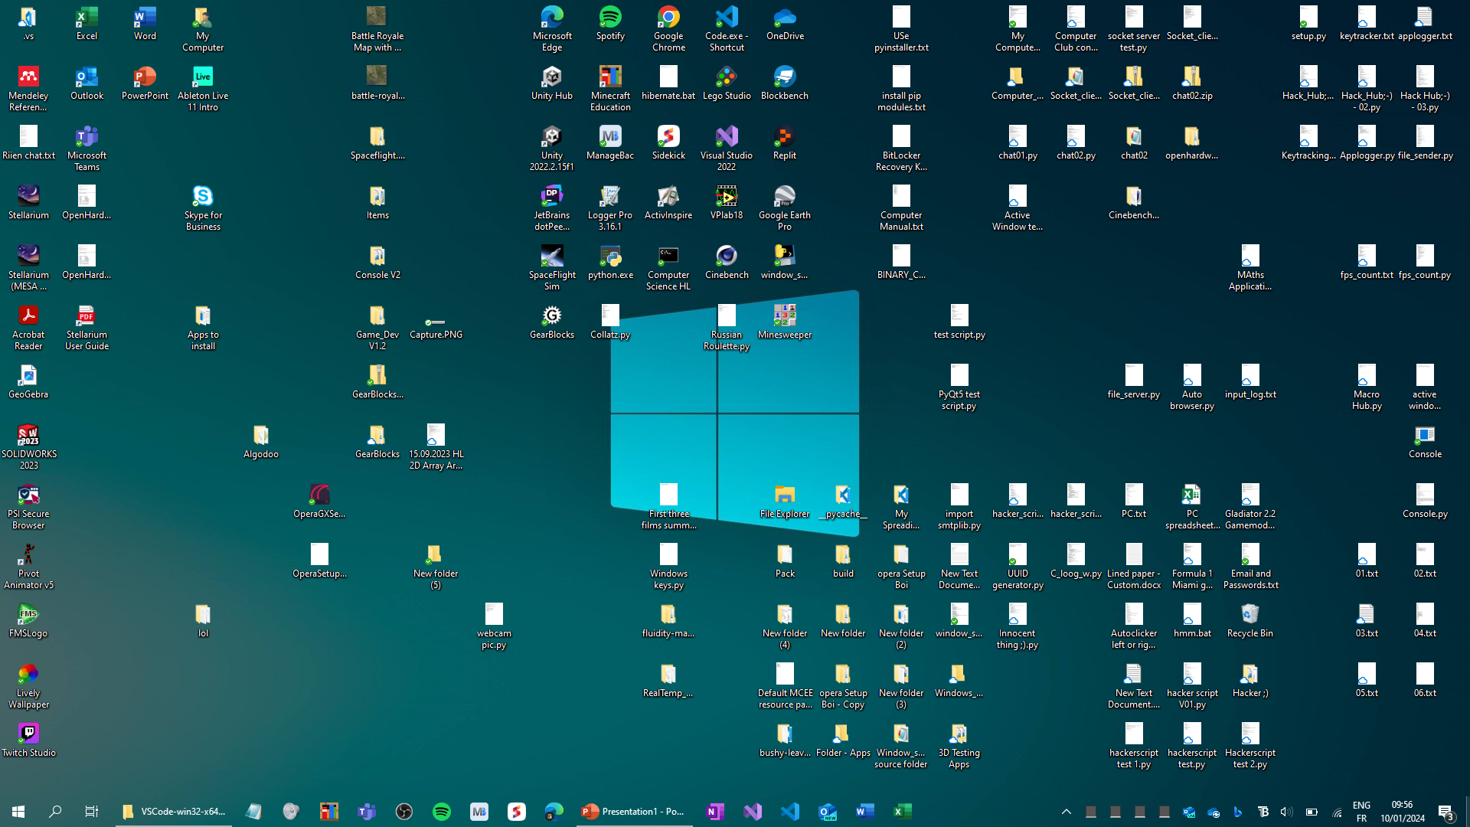
Download Visual Studio Code
Pin it on your Taskbar:

Slide 8
Download Visual Studio Code
DONE

